Slide 1
deep learning model
Notes:
용어: 남겨놓는 걸 test, 학습시킬 때 보는 걸 validation

Slide 2
purpose
process
result
tumor stage의 분류와 AE 최적화를 통해서 이전의 modeling되었던 layer을 만들어질 model에다 transfer learning을 진행하고 meta 데이터로는 >0.89, 서울대 임상 데이터로는 >0.75 의 결과 나올 수 있도록 해야함
AE로 각 tumor stage specific한 gene을 추출하고 이를 이용하여 model의 loss를 확인한다.
AE로 추출한 gene 수: 158 (기준: fold>2, p<0.001)
deep model의 loss:

Slide 3
Autoencoder
purpose | with fixed dimension 10,000 and layer_num 10, find the optimal contraction ratio
process | check the test loss while increasing node number by 10 (10~1000)
result | the loss doesn’t decrease significantly when node number is bigger than 100 (100: 0.173 200: 0.169 300:0.165)
 | chosen middle node: 175
 | loss: 0.11

Slide 4
raw data
10535 sample with 22204 genes (pancancer)
used sample
10535 sample with randomly chosen 10,000 genes (pancancer)
train(0.5) | 5267
validation(0.4) | 4214
test(0.1) | 1054
Total | 10535
used function
activation function: ReLU loss function: MSE
Notes:
DEEP LEARNING REGRESSION MODEL을 말로도 써주고 그림으로도 그려주고 하기.

Slide 5
<ovary cancer patient classification> -5 fold
OV | total(331) | train (0.7) | test (0.2) | val (0.1)
stage1 | 0 | 0 | 0 | 0
stage2 | 13 | 8 | 3 | 2
stage3 | 267 | 186 | 54 | 27
stage4 | 51 | 35 | 11 | 5
total | 331 | 234 | 65 | 32
<activated stage for TCGA>
Stage | count | prob
stage2 | 9265 | 0.41726715907043777
stage3 | 4688 | 0.21113312916591606
stage4 | 8251 | 0.3715997117636462
total | 22202 | 1

Slide 6

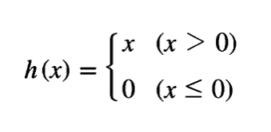
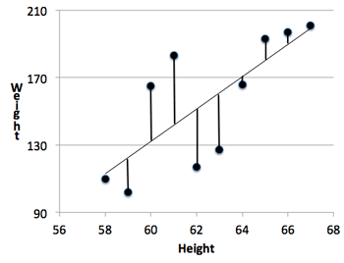
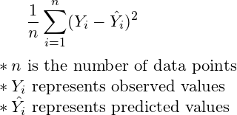
ReLU
Rectified Linear Unit
MSE
Mean Squared Error
Notes:
relu: https://ailephant.com/glossary/relu-function/, https://blog.naver.com/godbswkd123/221349336221
mse: https://study.com/academy/lesson/estimation-of-r-squared-variance-of-epsilon-definition-examples.html

Slide 7
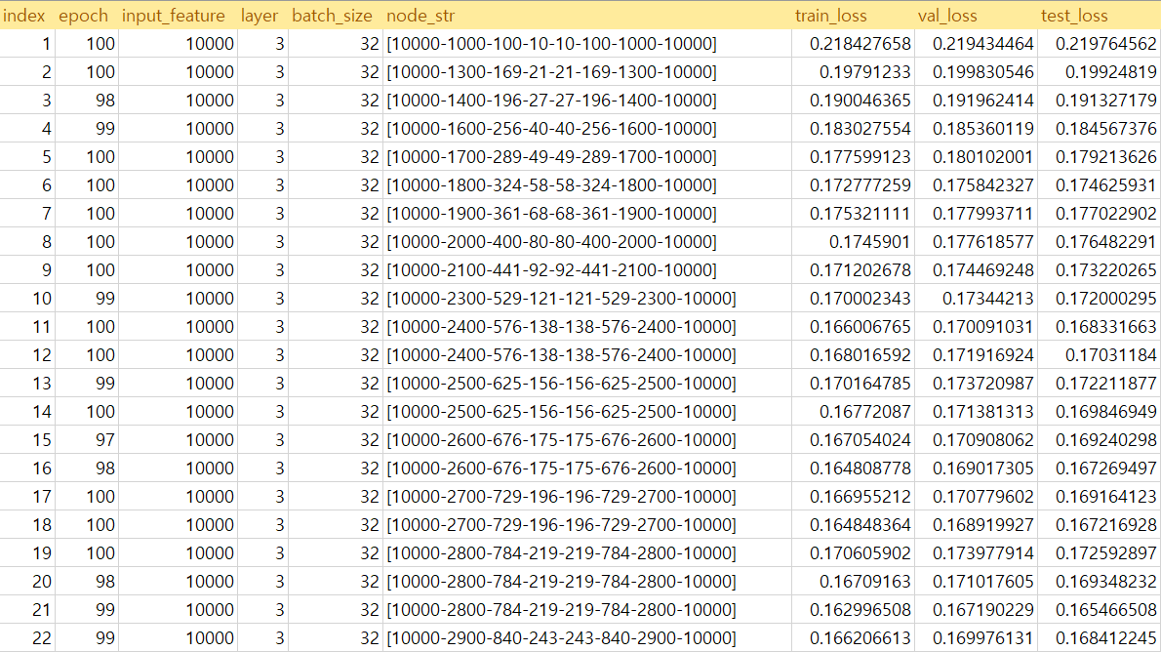

Slide 8
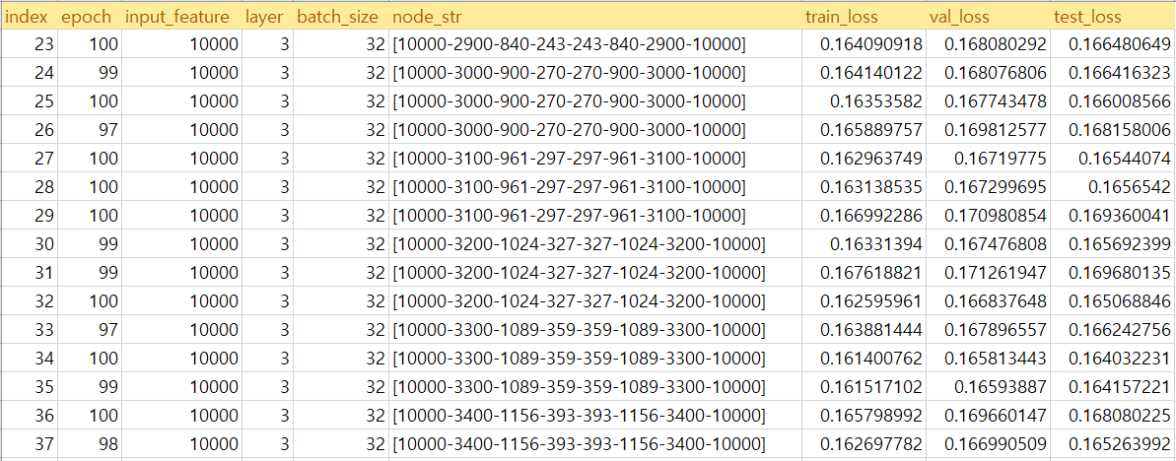

Slide 9
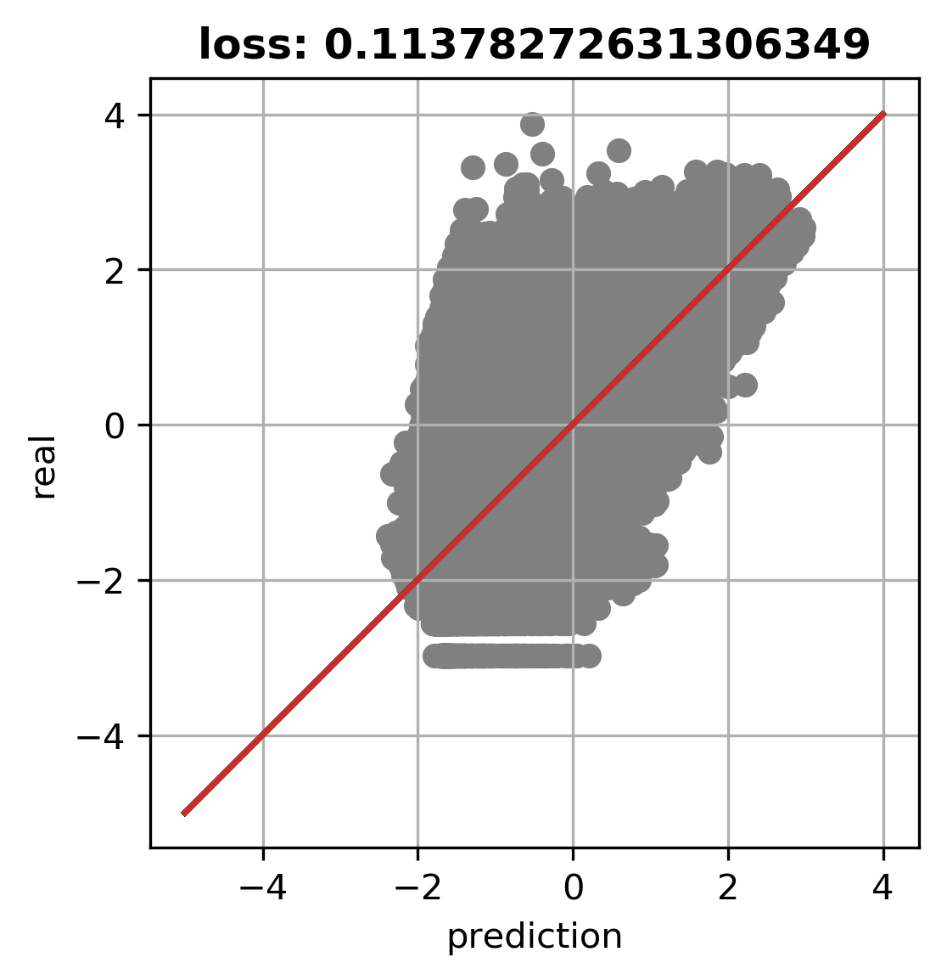
matplot
*used model: [10000-2600-676-175-175-676-2600-10000]_100.hdf5

Slide 10
기존 논문과 성능 비교
Method | Hyperparameter | Hyperparameter value | MSE
Lasso | α | 0.05 | 0.3516
 |  | 0.7 | 0.2912
Random forests | Number of estimators | 10 | 0.3221
 |  | 200 | 0.2967
MLP-SAE model | Learning rate | 0.1 | 0.2890
 |  | 0.00001 | 0.2918
현재 AE 최고 성능(MSE) : 0.16
기존 논문 AE 성능(MSE) : 0.289
7 085 genes measured in 112 samples
비교논문
https://bmcgenomics.biomedcentral.com/articles/10.1186/s12864-017-4226-0
Notes:
⇒ 비슷한 논문 찾아보기.
TCGA 데이터로 AE, SAE, SDA 비교논문 찾기.
전체 데이터가 몇 개고, 그 중 몇 개를 썼는지.
양쪽 전체 데이터 몇 개인지
영어로 쓰기

Slide 11
Deep Model - PanCancer
Deep Model - PanCancer
data preparation
result
graph

Slide 12
Deep Model
purpose | increase the accuracy to >0.89 (meta) and >0.75 (Seoul’s clinical data)
process | do transfer learning
result | the loss doesn’t decrease significantly when node number is bigger than 100 (100: 0.173 200: 0.169 300:0.165)
 | chosen middle node: 175
 | loss: 0.11

Slide 13
1. Data Preparation
Used Data
Data Criteria
 | TCGA_clinical_Mother | TCGA_Meta
size | (10535, 22205) | (9607, 29)
after parsing | (7105, 22205) | (7105, 2)
 | feature | Sample (train:test:val)
variance | 1600 | 3045
fold change | 158 | 3045
fold change_st14 | 132 | 3045
auto encoder | 175 | 3045
 | 1500
(Pancancer)
Notes:
fold change_st14: when mapped each genes to stage, use genes that matched to stage 1or 4 among genes selected by fold change

Slide 14
select label and number of feature
leave only common sample and exclude NA
Meta: leave only the sample name and selected label
Mother: select genes according to criteria mentioned before
divide both data according to train:val ratio (0.85:0.15, train:test=0.8:0.2)
 | TCGA_clinical_Mother | TCGA_Meta
size | (10535, 22205) | (9607, 29)
after parsing 1 | (7105, 22205) | (7105, 2)
after parsing 2 | - | (3045, 2)
(global cancer)

Slide 15
Criterion: fold change (train:val = 1:1)
 | Fold_change | P-Value | count
stage1 | >2 | <0.001 | 83
stage2 | >2 | <0.001 | 23
stage3 | >2 | <0.001 | 3
stage4 | >2 | <0.001 | 49
total |  |  | 158
TCGA_Meta Classification for pancancer
 | total
stage 1 | 1960
stage 2 | 2084
stage 3 | 1645
stage 4 | 790
TOTAL | 6479 (9607 -NA)
 | Fold_change | P-Value | count
stage1 | >1.7 | <0.001 | 110
stage2 | >0.8 | <0.001 | 92
stage3 | >0.15 | <0.001 | 106
stage4 | >1.3 | <0.001 | 101
total |  |  | 409
Extraction method: Compare the average of the expression values all genes have at each stage. And map genes with the stage that has the highest value.
adjusted the fold change value to make total number of genes to be around 400

Slide 16
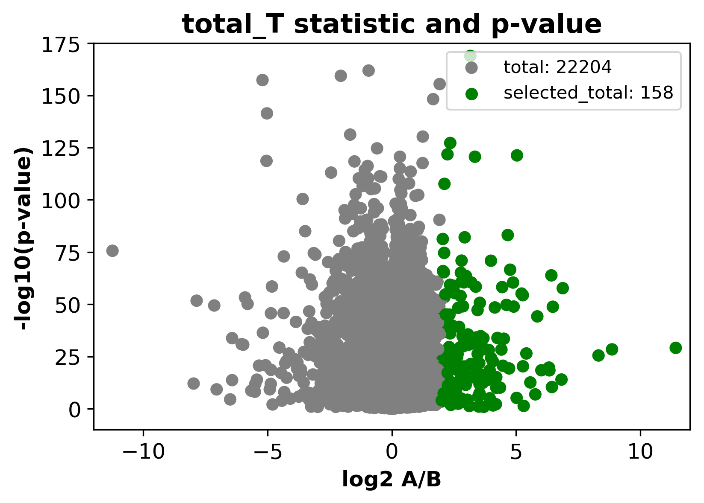
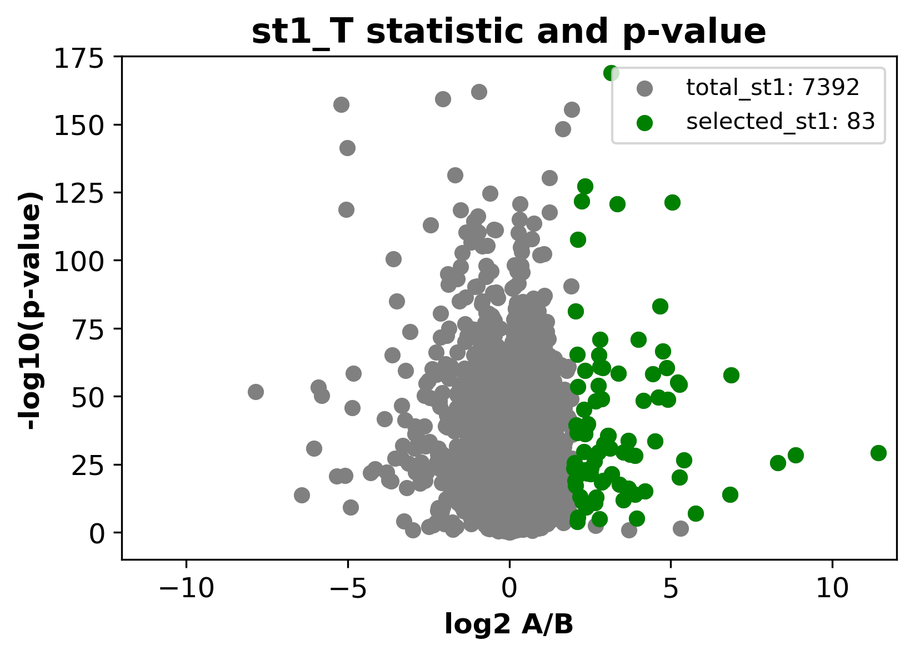
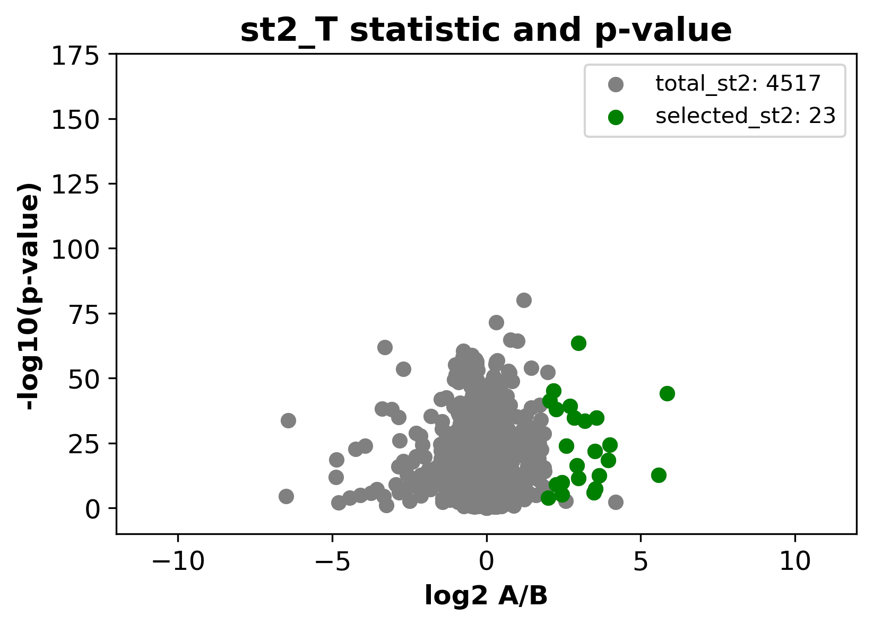
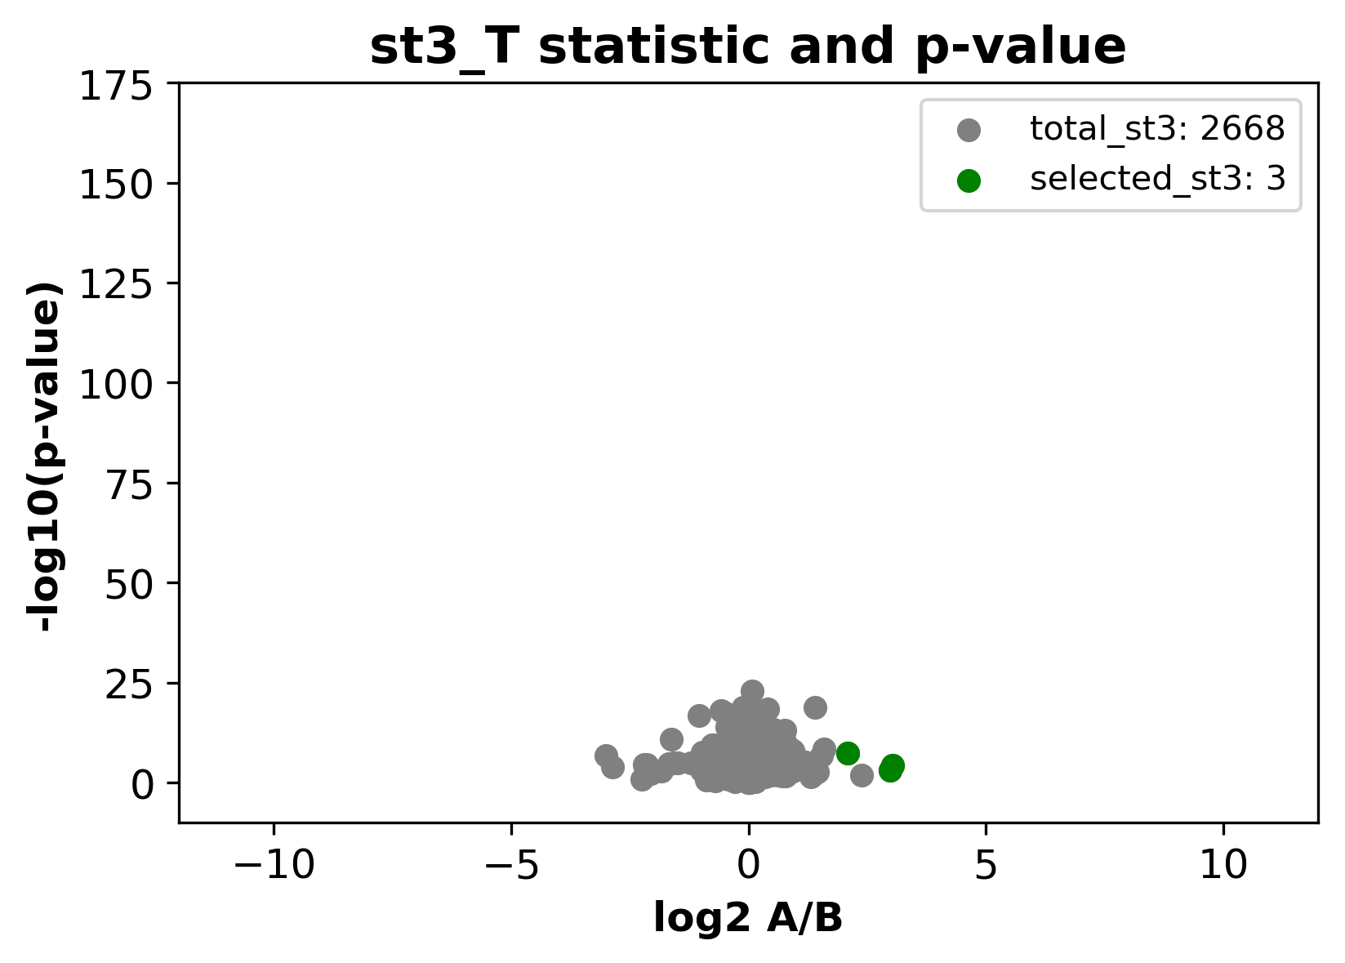
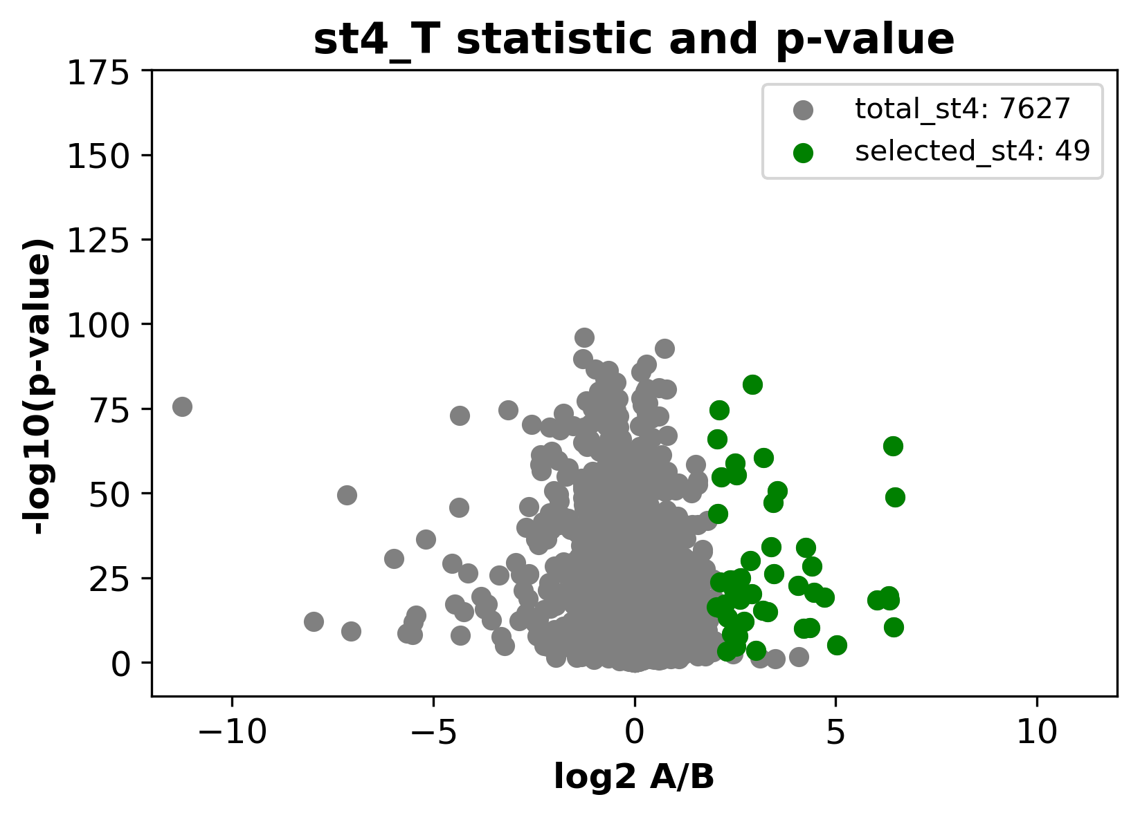

Slide 17
TCGA_Mother 교차분할표 for global cancer (train:test = 1:1)
 | train | test
stage 1 | 1089 | 1088
stage 2 | 1142 | 1141
stage 3 | 889 | 888
stage 4 | 434 | 434
TOTAL | 3554 | 3551 | 7105 (9607 중 NA제외)

Slide 18
2. Run DNN
input dimension | train_x.shape[1]
output dimension | train_y.shape[1]
layer | 4
node percentage | 0.6 0.8 0.6 0.8
activation function | relu / sigmoid
loss function | categorical_crossentropy
optimizer | adam
fit | model.fit(train_x, train_y, validation_data = (test_x, test_y), epochs=10, batch_size=batch_size, verbose=0 ,callbacks=[cb_checkpoint, cb_early_stopping])
for all stages

Slide 19
3. Result
gene selection criteria (#feature) | train:test(:val) | train acc | test acc
var (1600) | 3562:3562 | 0.8172375070352624 | 0.46743402589512034
fold change (158) | 3554:3551 (total sample_7105) | 0.5365785 | 0.49647987
AE (175) | 3554:3551 (total sample_7105) | 0.5123177278670931 | 0.4966367824479189
Notes:
var 1600: https://drive.google.com/drive/u/1/folders/1NCb08EEfdCYmmVGcUL8P0oQ7dUPO7Kmk

Slide 20
Confusion Matrix
 | stage1 | stage2 | stage3 | stage4
pre_stage1 | 764 | 240 | 268 | 109
pre_stage2 | 245 | 769 | 457 | 155
pre_stage3 | 43 | 56 | 87 | 28
pre_stage4 | 36 | 76 | 76 | 142
 |  |  |  |  | 1762/3551
(gene: fold change 158)
 | stage1 | stage2 | stage3 | stage4
pre_stage1 | 811 | 298 | 298 | 134
pre_stage2 | 194 | 667 | 334 | 138
pre_stage3 | 76 | 156 | 219 | 86
pre_stage4 | 7 | 20 | 37 | 76
 |  |  |  |  | 1773/3551
(gene: fold change 409)

Slide 21
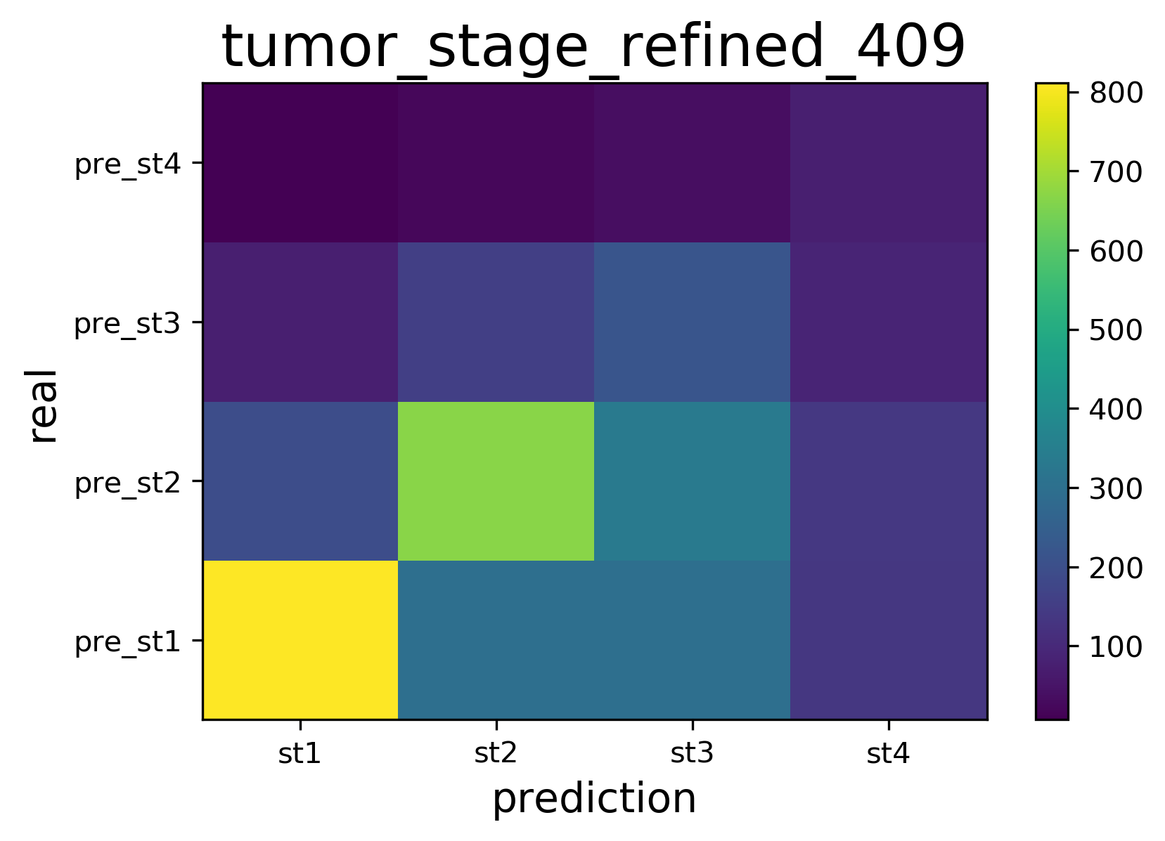
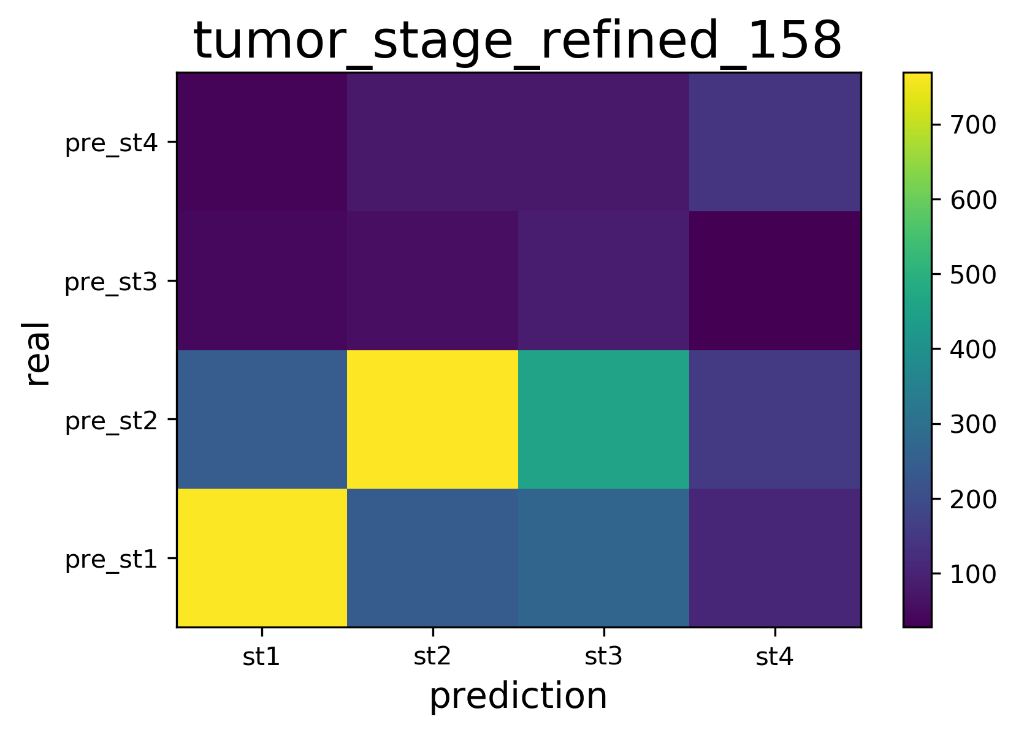

Slide 22
2. Run DNN
input dimension | train_x.shape[1]
output dimension | train_y.shape[1]
feature | 15019 (only stage 1,4)
layer | 4
node percentage | 0.6 0.8 0.6 0.8
activation function | relu / sigmoid
loss function | categorical_crossentropy
optimizer | adam (lr=0.00001)
fit | model.fit(train_x, train_y, validation_data = (test_x, test_y), epochs=10, batch_size=batch_size, verbose=0 ,callbacks=[cb_checkpoint, cb_early_stopping])
for stage 1,4 only
Train Data : 1217, Test Data : 1522, Validation Data : 306, Training Epochs : 1
Training Accuracy : 1.0
Validation Accuracy : 0.8562091588973999
Test Accuracy :0.8574244379997253
Execution time : 0.0 Days 0.0 Hour 14.0 Min 17 Sec

Slide 23
3. Result
gene selection criteria (#feature) | train:test(:val) | train acc | test acc
stage1, 4 only (15019) | 1217:1522:306 (total sample_3045) | 1.0 | 0.857
var (500) (random 500 among st1,4(15019)) | 1217:1522:306 (total sample_3045) | 0.83 | 0.814

Slide 24
Confusion Matrix
 | stage1 | stage4
pre_stage1 | 1016 | 207
pre_stage4 | 72 | 227
 |  |  | 1522
(gene: fold_stage1,4 )
 | stage1 | stage4
pre_stage1 | 995 | 190
pre_stage4 | 93 | 244
 |  |  | 1522
(gene: 500 among fold_stage1, 4 )
Notes:
7:2:1 (떼어놓는 건 test, 1)

Slide 25
3. Result
gene selection criteria (#feature) | train:test(:val) | train acc | test acc | auc score | note
15019 | 2060:477:508 (0.85*0.8 : 0.15 (:0.85*0.2)) (total sample_3045) | 0.905 | 0.828 | 0.789 | -stage 1,4 -balanced tumor species -0724

Slide 26
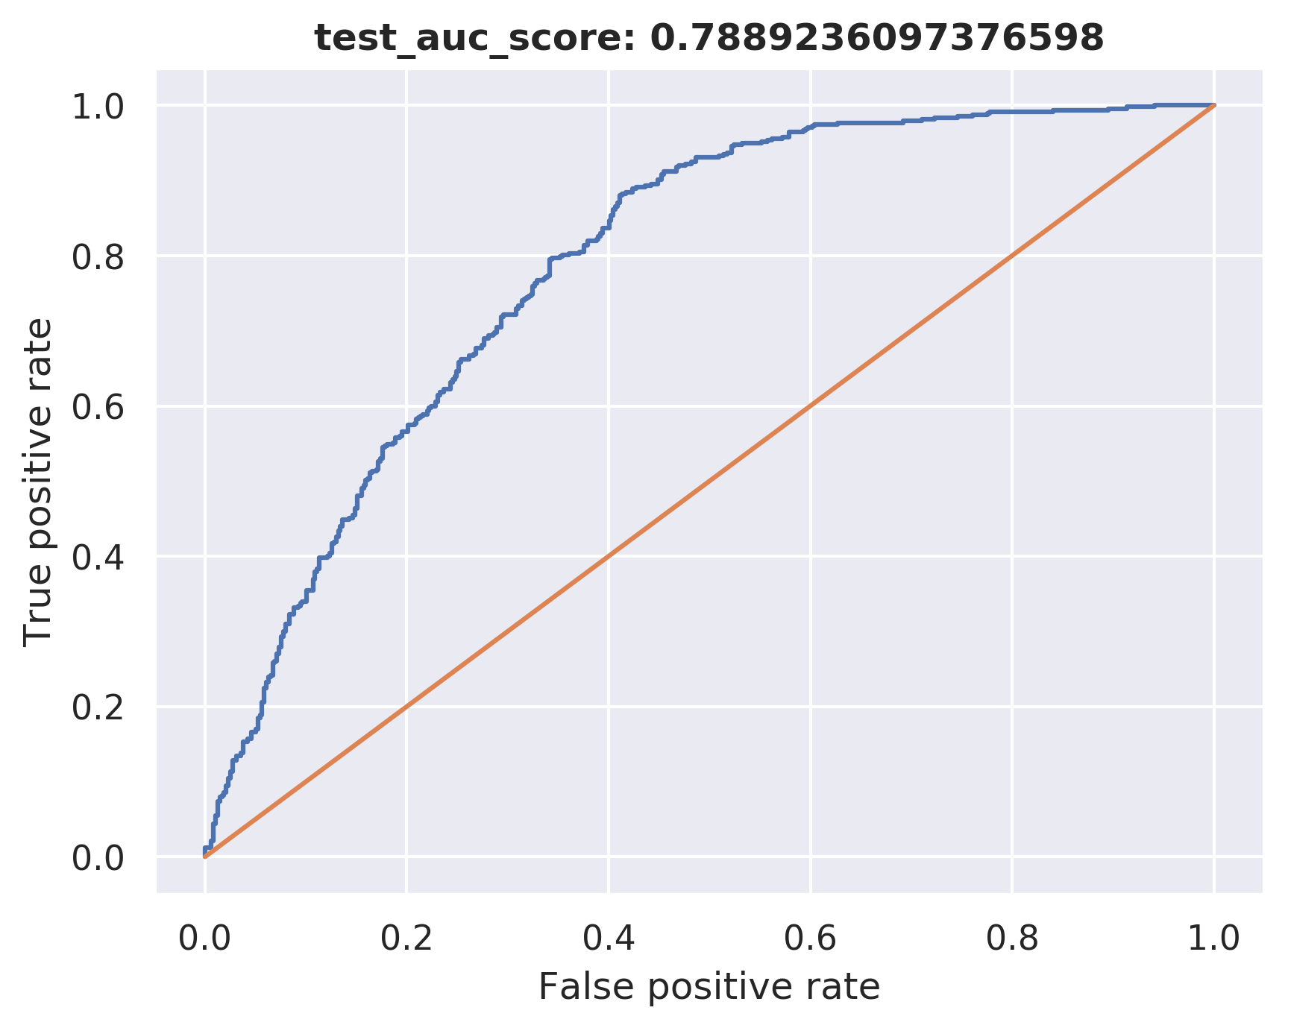

Slide 27
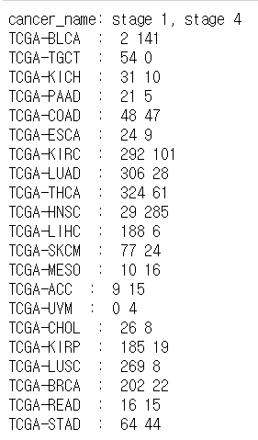
3. Result for each cancer
<- real value

Slide 28
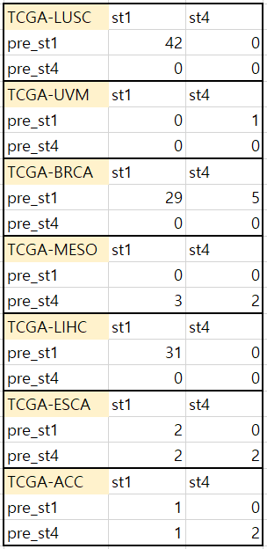
name of the cancer | train:test(:val) | train acc | test acc | auc score
TCGA-LUSC | 188:42:47 | 1 | 1 | 1
TCGA-UVM | 2:1:1 | 0 | 0 | 0
TCGA-BRCA | 152:32:38 | 1 | 0.85 | 0.85
TCGA-MESO | 17:5:4 | 0.76 | 0.4 | 0.4
TCGA-LIHC | 131:31:32 | 1 | 1 | 1
TCGA-ESCA | 22:6:5 | 1 | 0.67 | 0.67
TCGA-ACC | 16:4:4 | 1 | 0.75 | 0.75

Slide 29
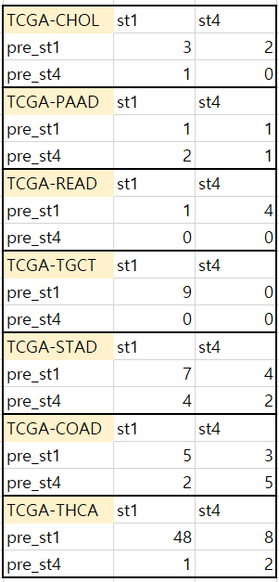
name of the cancer | train:test(:val) | train acc | test acc | auc score
TCGA-CHOL | 23:6:5 | 0.86 | 0.5 | 0.5
TCGA-PAAD | 27:5:5 | 1 | 0.4 | 0.4
TCGA-READ | 17:5:4 | 0.81 | 0.2 | 0.2
TCGA-TGCT | 36:9:9 | 1 | 1 | 1
TCGA-STAD | 73:17:18 | 0.74 | 0.53 | 0.53
TCGA-COAD | 64:15:16 | 1 | 0.67 | 0.67
TCGA-THCA | 261:59:65 | 1 | 0.85 | 0.85

Slide 30
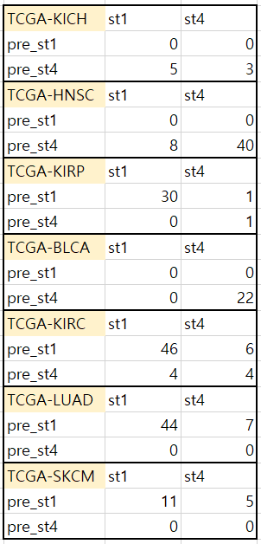
name of the cancer | train:test(:val) | train acc | test acc | auc score
TCGA-KICH | 27:8:6 | 0.40 | 0.38 | 0.38
TCGA-HNSC | 213:48:53 | 1 | 0.83 | 0.83
TCGA-KIRP | 138:32:34 | 1 | 0.97 | 0.97
TCGA-BLCA | 97:22:24 | 1 | 1 | 1
TCGA-KIRC | 267:60:66 | 0.99 | 0.83 | 0.83
TCGA-LUAD | 227:51:56 | 1 | 0.86 | 0.86
TCGA-SKCM | 68:16:17 | 1 | 0.69 | 0.69

Slide 31
2. Run DNN
input dimension | train_x.shape[1]
output dimension | train_y.shape[1]
layer | 4
node percentage | 0.6 0.8 0.6 0.8
activation function | relu / sigmoid
loss function | categorical_crossentropy
optimizer | adam
fit | model.fit(train_x, train_y, validation_data = (test_x, test_y), epochs=10, batch_size=batch_size, verbose=0 ,callbacks=[cb_checkpoint, cb_early_stopping])
dropout | 0.2~0.6
for stage 1,4 only

Slide 32
3. Result
gene selection criteria (#feature) | train:test(:val) | train acc | test acc | auc score | note
15019 | 2060:477:508 (0.85*0.8 : 0.15 (:0.85*0.2)) (total sample_3045) | 0.905 | 0.828 | 0.789 | -stage 1,4 -balanced tumor species -0724 -비교용(dropout X)
15019 | 2060:477:508 | 0.751 | 0.771 | 0.802 | dropout 0.6
15019 | 2060:477:508 | 0.79 | 0.800 | 0.801 | dropout 0.5
15019 | 2060:477:508 | 0.780 | 0.782 | 0.834 | dropout 0.4
15019 | 2060:477:508 | 0.813 | 0.776 | 0.837 | dropout 0.3
15019 | 2060:477:508 | 0.859 | 0.818 | 0.866 | dropout 0.2
1500 | 2060:477:508 | 0.71 | 0.470 | 0.461 | -used ae_extracted data -no dropout

Slide 33
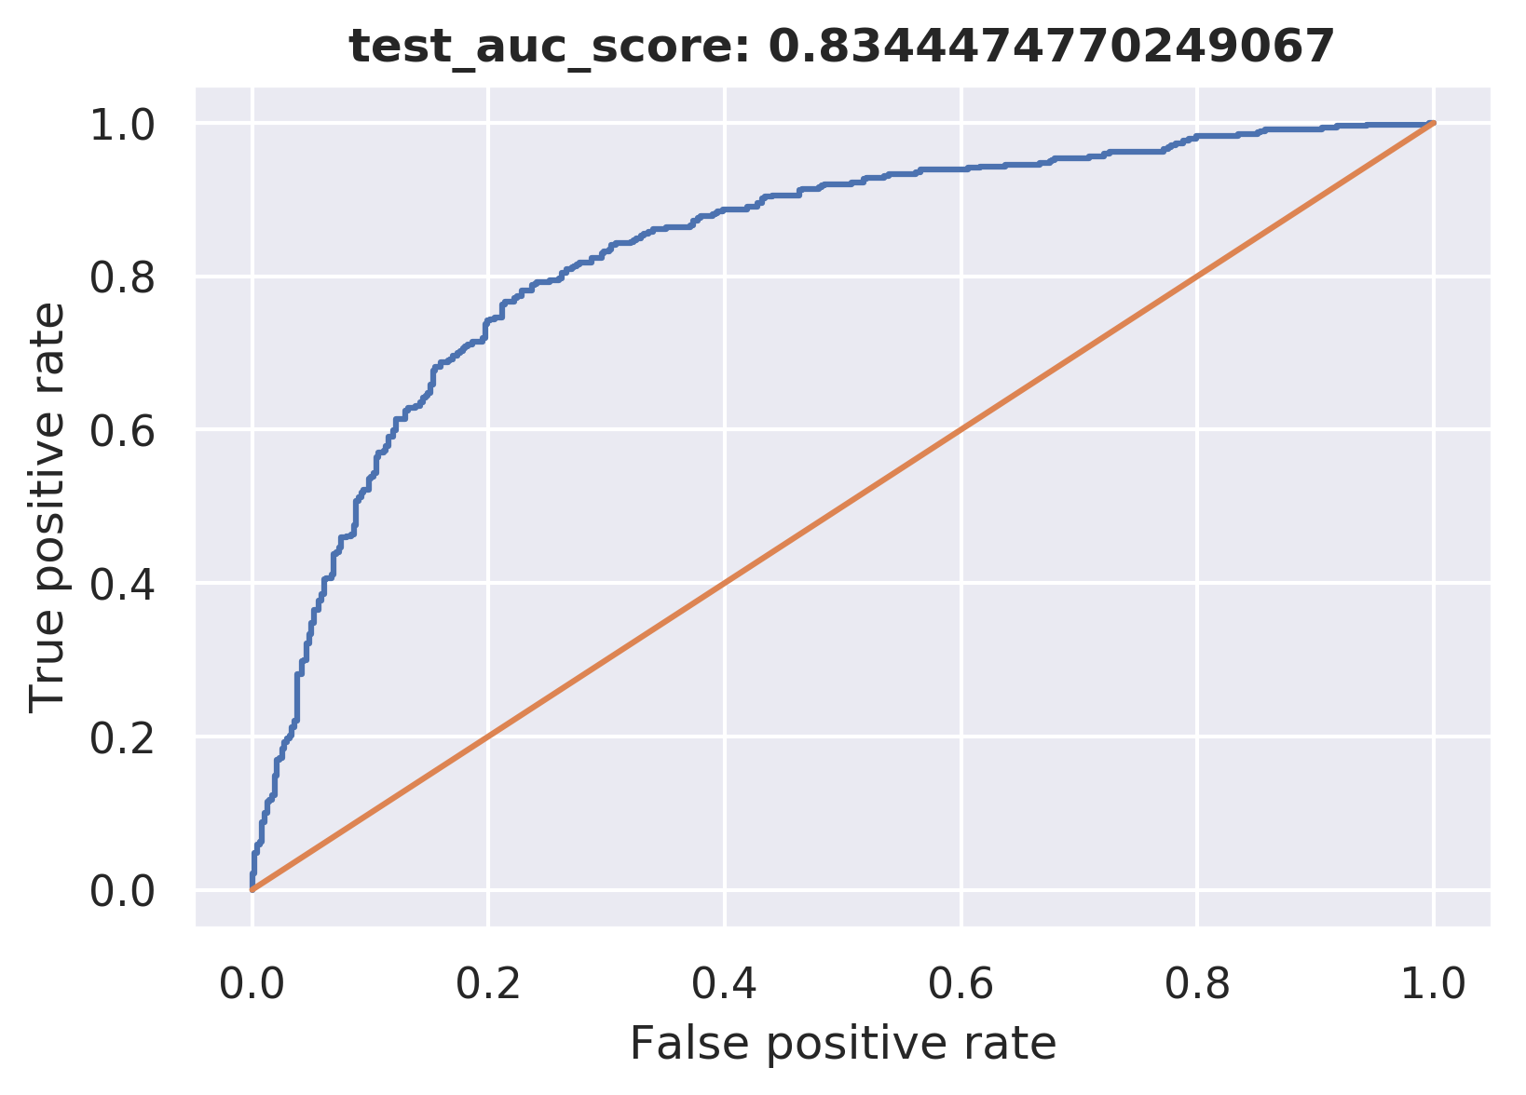
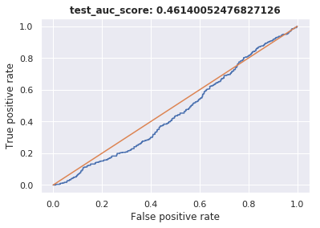

Slide 34
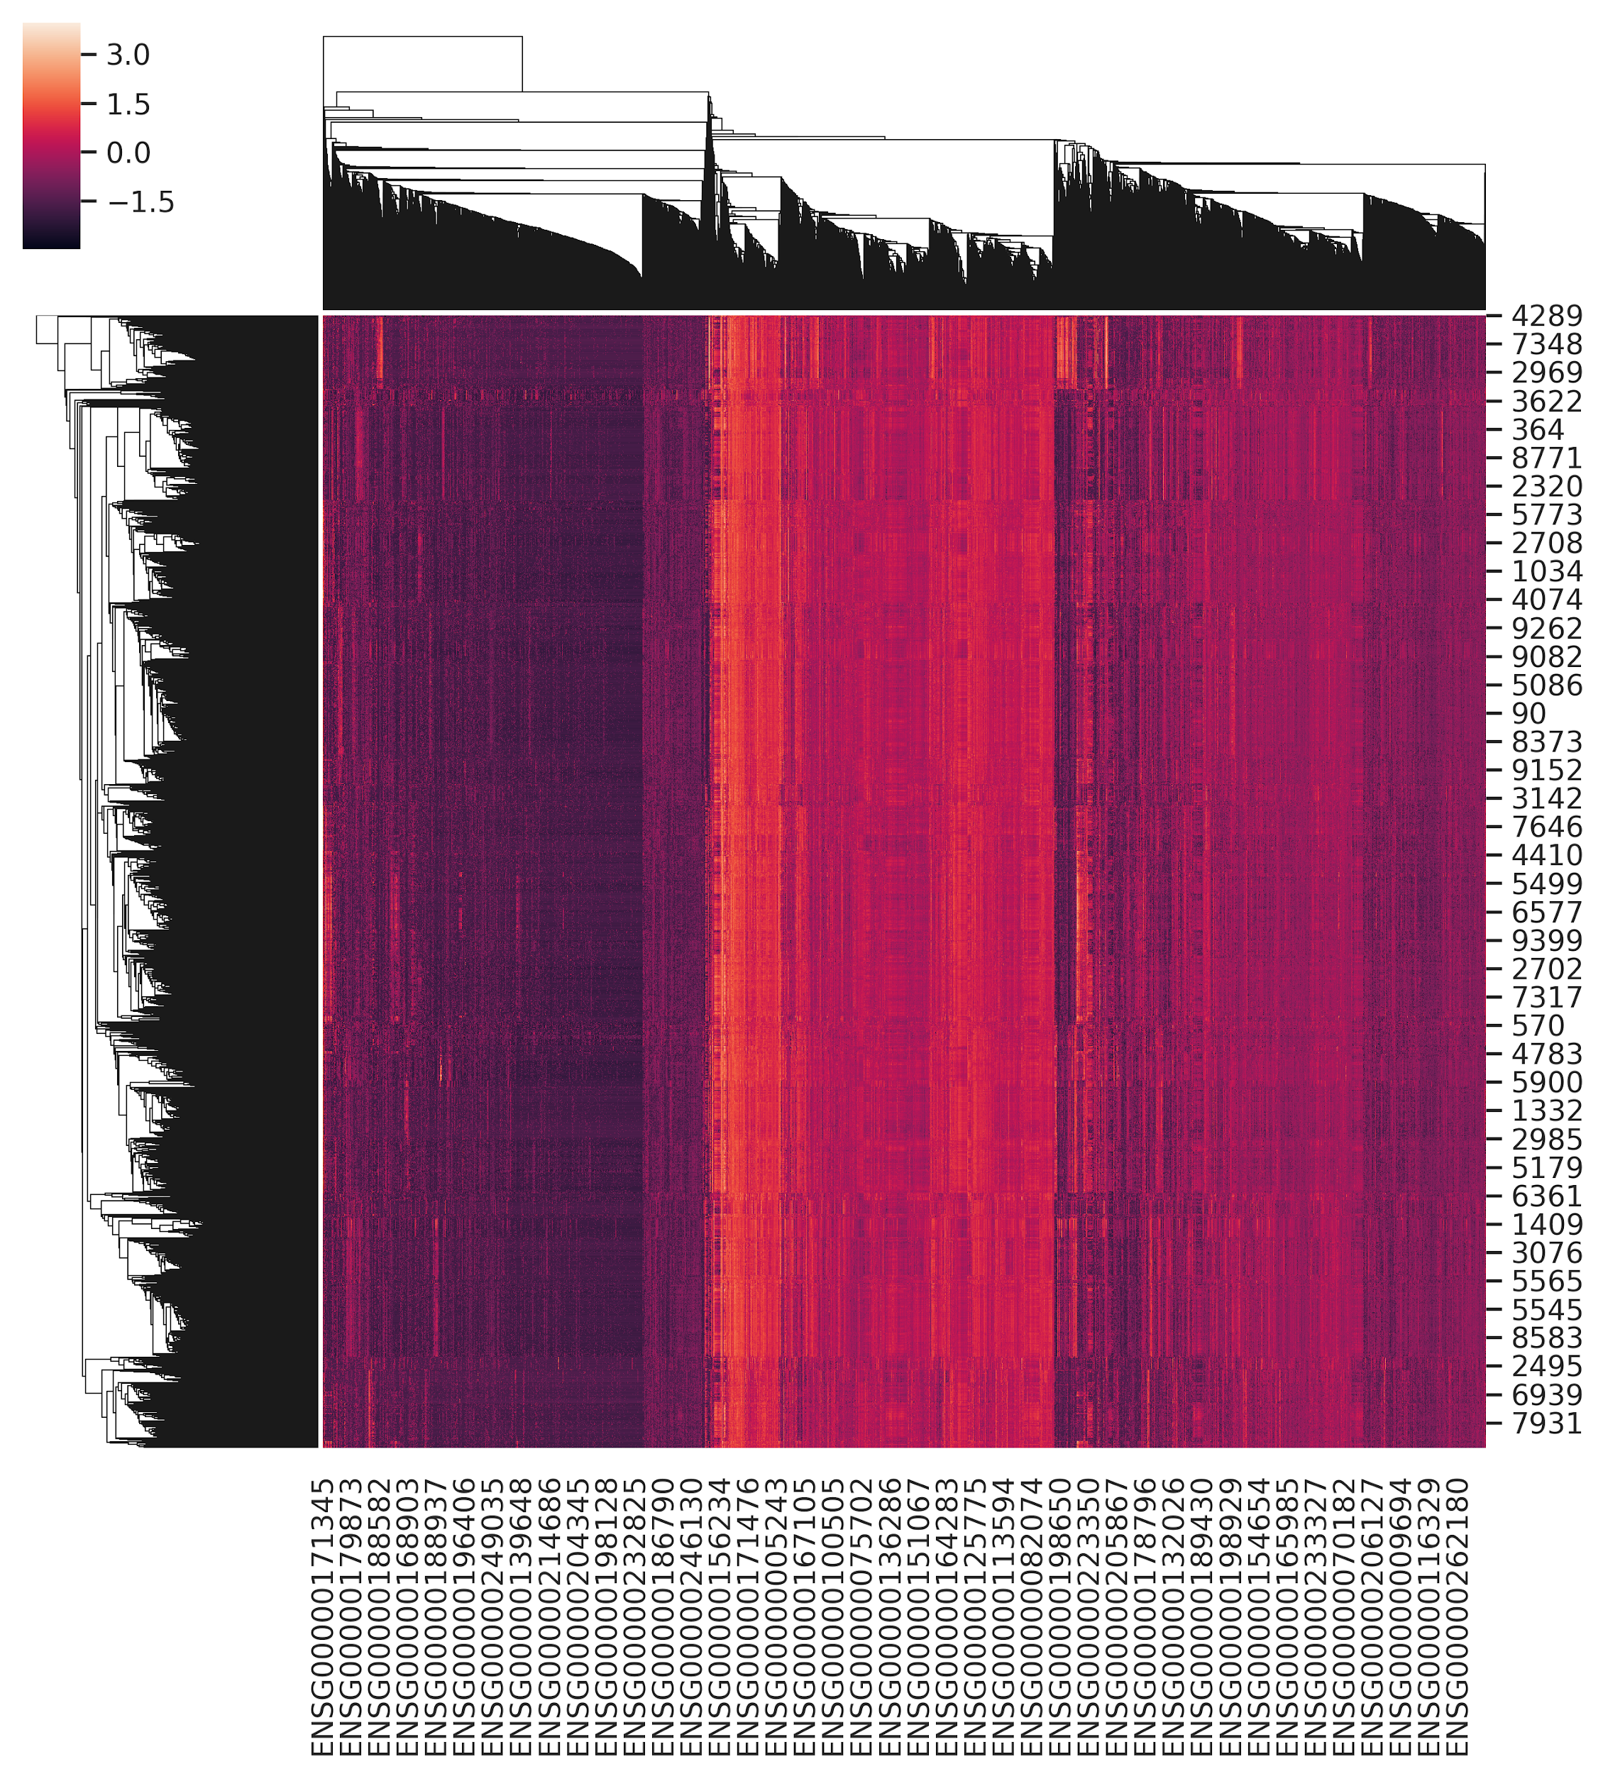
all gene

Slide 35
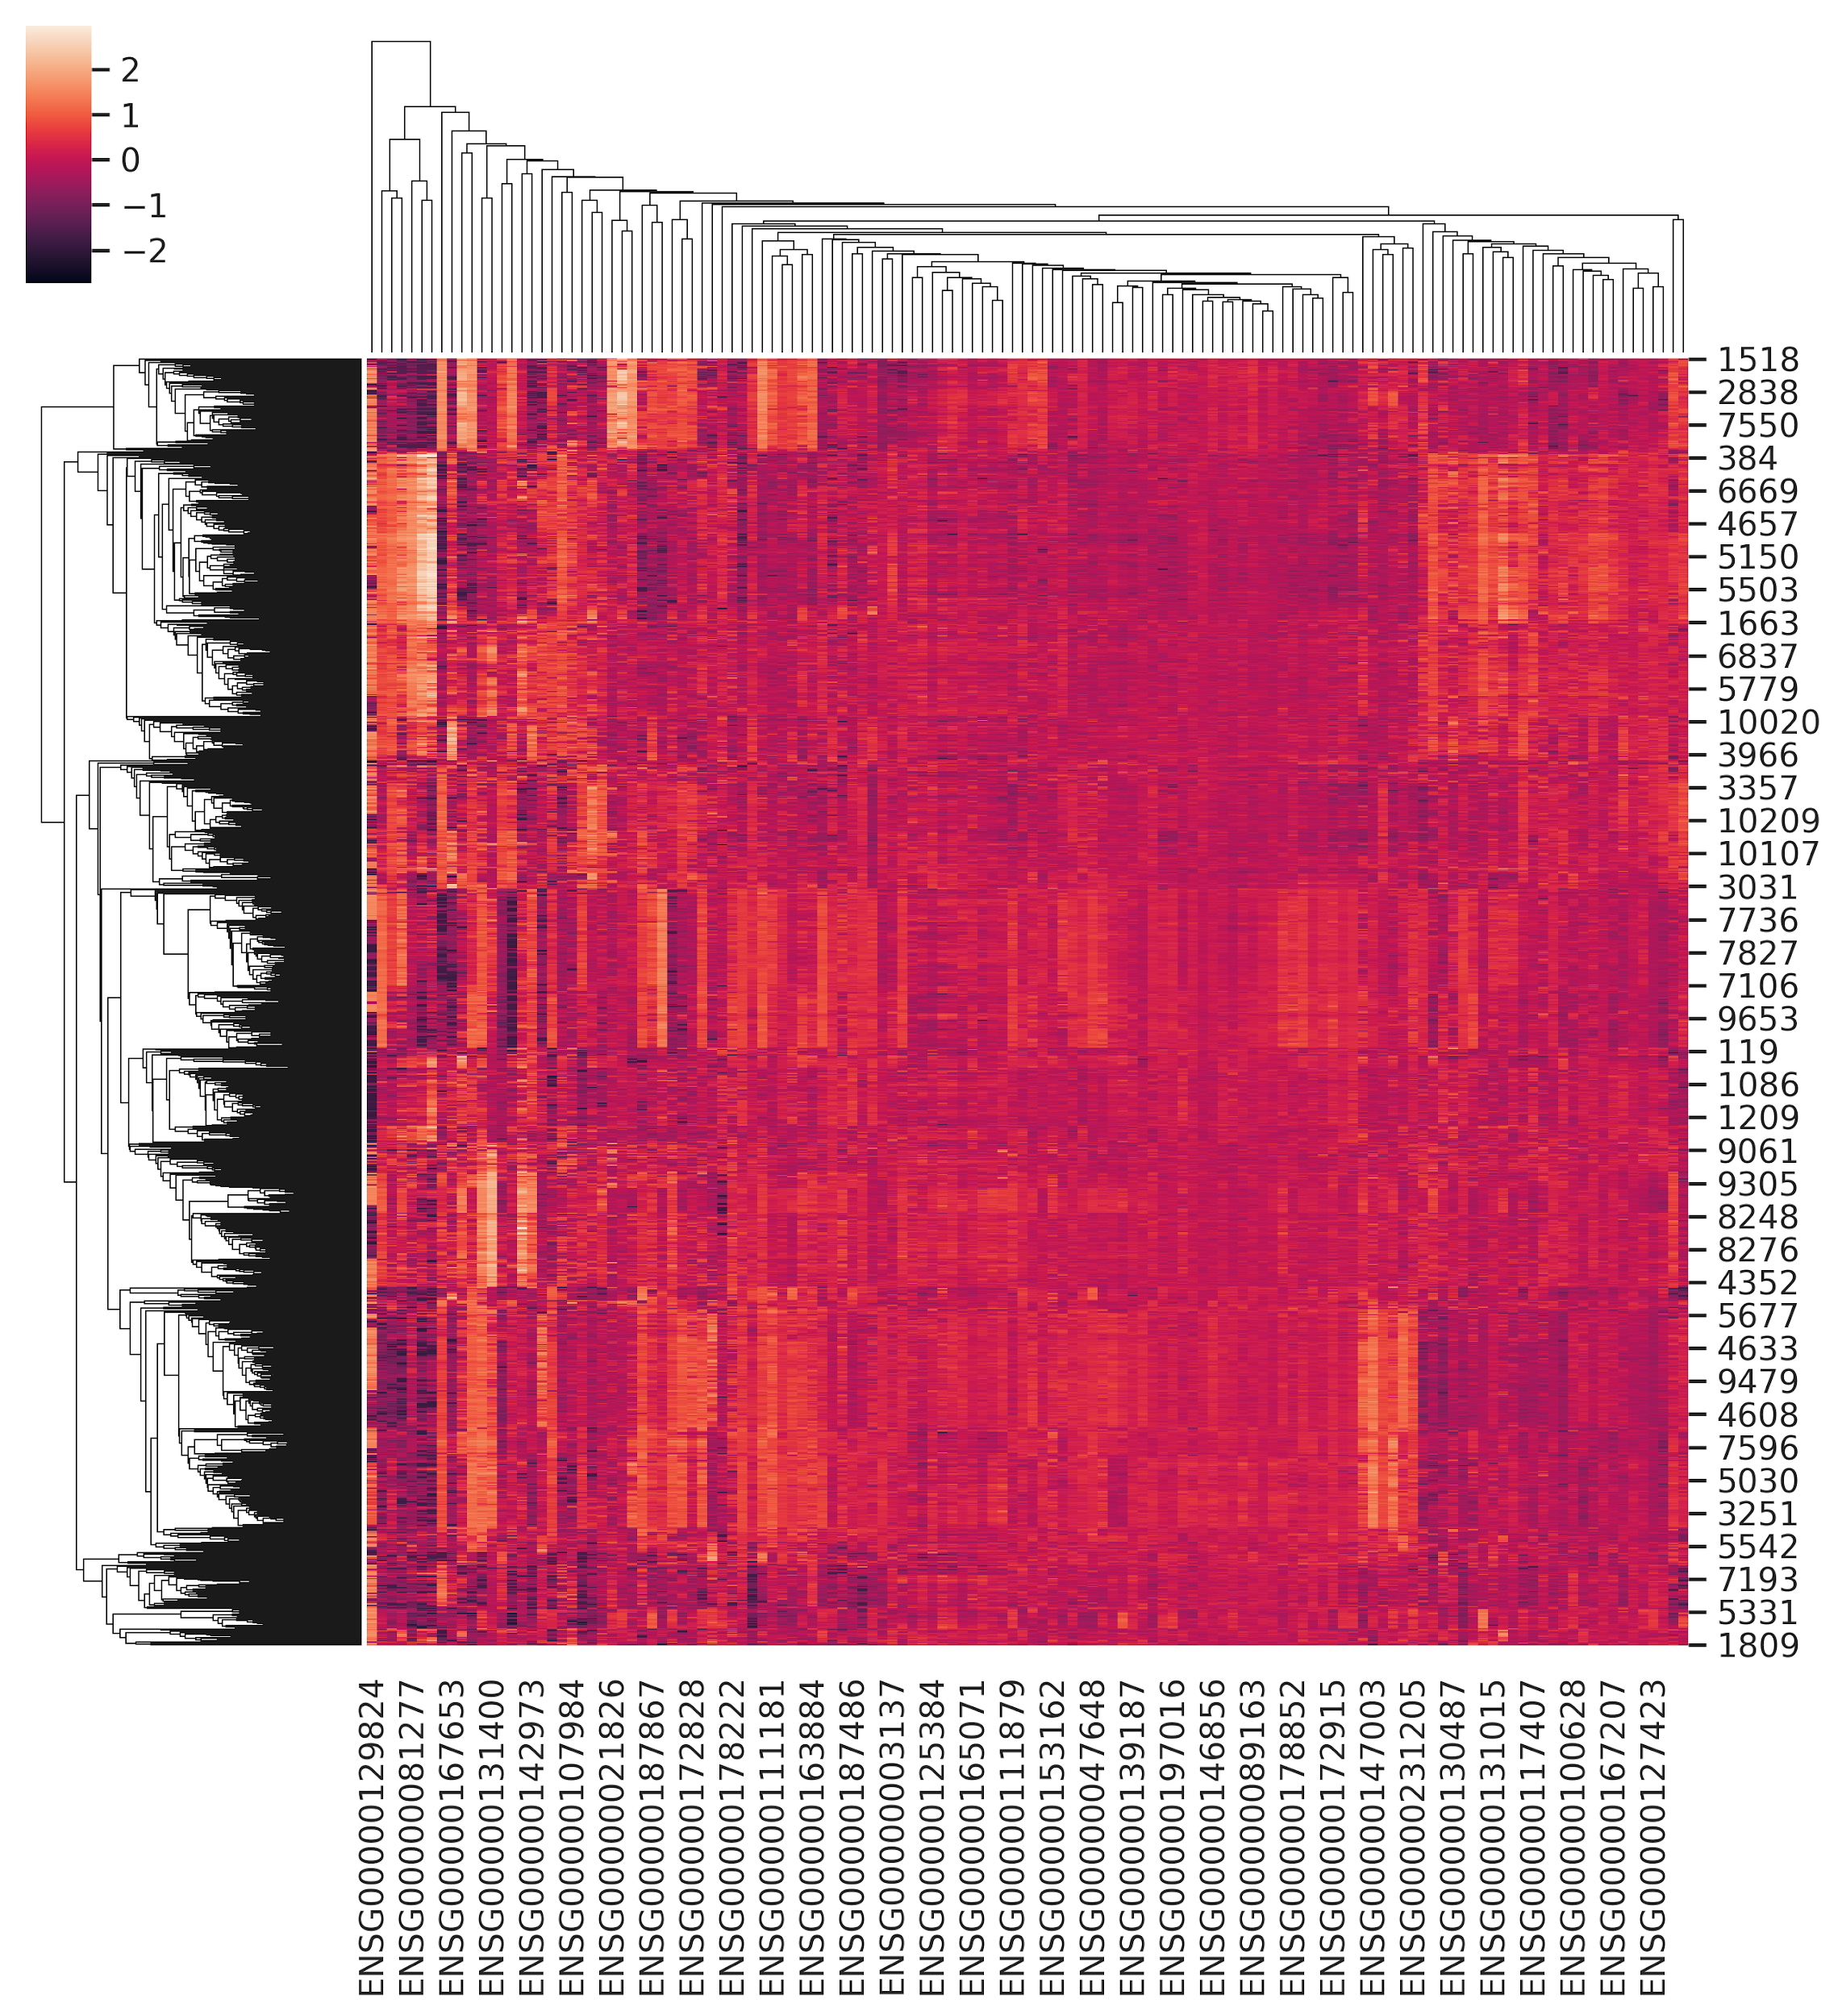
genes for stage 1,4
test_x, 1522

Slide 36
2. Run DNN
input dimension | train_x.shape[1]
output dimension | train_y.shape[1]
layer | 3 or 4
node percentage | combination of 0.6, 0.8
activation function | relu / sigmoid
loss function | categorical_crossentropy
optimizer | adam
fit | model.fit(train_x, train_y, validation_data = (test_x, test_y), epochs=10, batch_size=batch_size, verbose=0 ,callbacks=[cb_checkpoint, cb_early_stopping])
dropout | 0.1, 0.2 or 0.3
for stage 1,4 only
find best result of various combinations

Slide 37
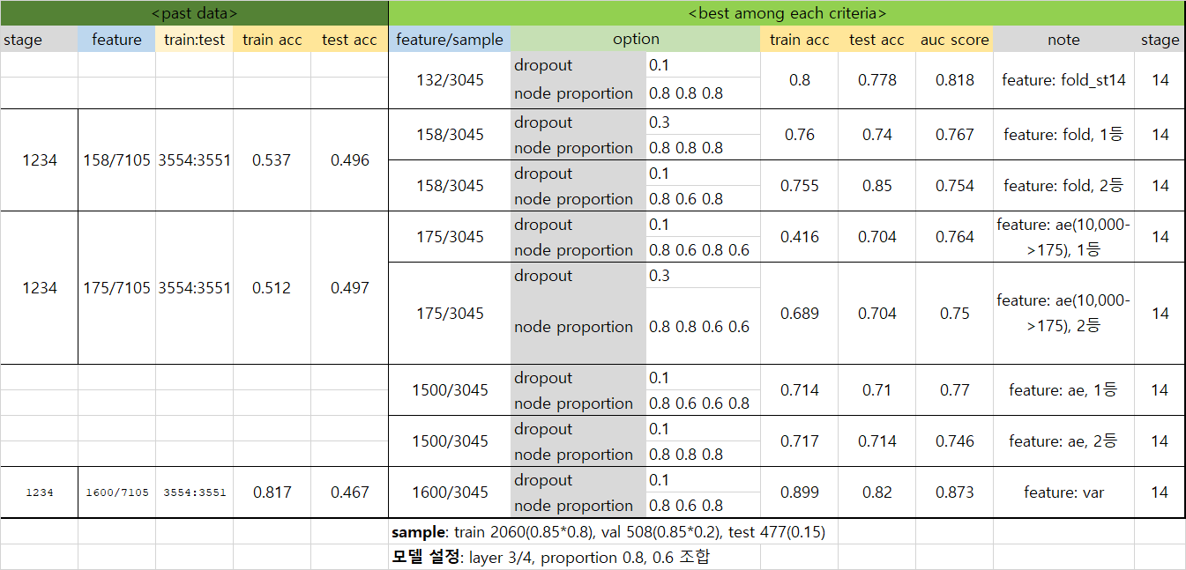

Slide 38
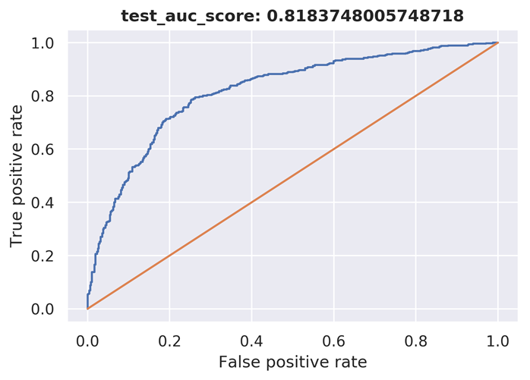
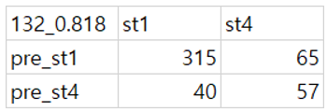
3. Result

Slide 39
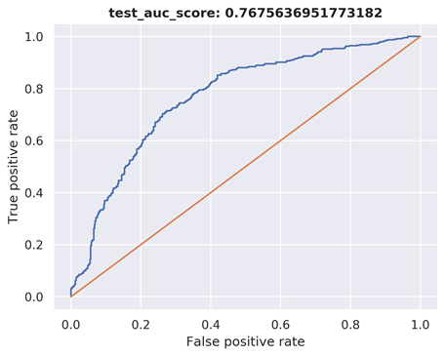
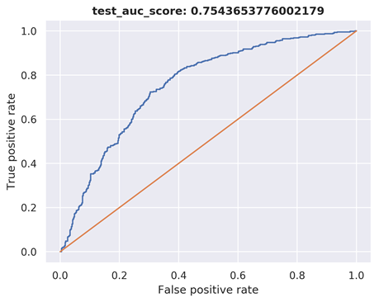
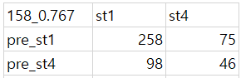
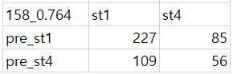

Slide 40
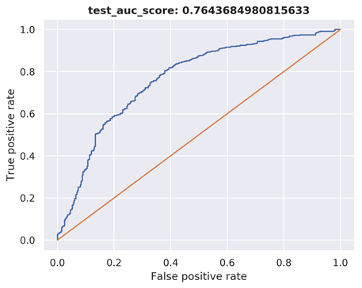

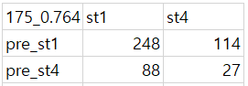
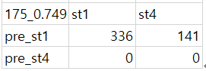

Slide 41
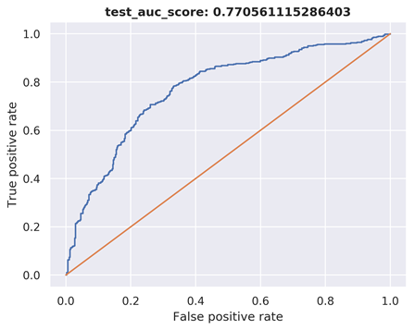

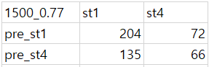
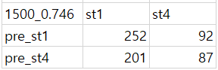

Slide 42
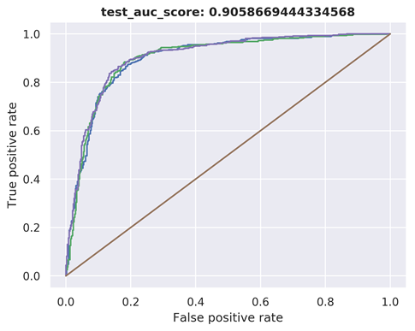
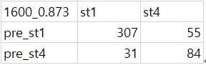
(green line)

Slide 45
Deep Model
purpose | increase the accuracy to >0.89 (meta) and >0.75 (Seoul’s clinical data)
process | do transfer learning
result | the loss doesn’t decrease significantly when node number is bigger than 100 (100: 0.173 200: 0.169 300:0.165)
 | chosen middle node: 175
 | loss: 0.11

Slide 46
Random_sampleing & 10-fold cross validation
Random Sampling Best Model
layer :3
node_proportion : 0.6,0.8,0.6
feature : 1600
Test_acc : 0.634615386
Train_acc : 0.984126985
Val-acc : 0.793913054
sample: 6개월 이해

Slide 48
Deep Model-Ovary Cancer

Slide 49
Tumor Stage Classification
Purpose
Classification each tumor stage for ovary cancer
Process
Make a 5-fold cross validation gene selection model and compare pre-model

Slide 50
Classification each tumor stage for ovary cancer
1.Extract only ovarian cancer patient from original TCGA meta data
2. Mapping stage each ovary cancer patient as clinical data
3. Except NA values and selected exist values
project_id | Classification | count | total sample
TCGA-OV | stage2 | 13 | 422
 | stage3 | 267
 | stage4 | 51
 | NA | 91

Slide 51
Random_sampleing & 5-fold cross validation
Random Sampling Best Model
layer :4
node_proportion : 0.6,0.8,0.6,0.8
feature : 331
Test_acc : 0.8153846263885498
Train_acc : 0.8260869383811951
Val-acc : 0.7777777910232544
5-fold cross validation Best Model
layer :4
node_proportion : 0.6,0.8,0.6,0.8
feature : 331
Test_acc : 0.8999999761581421
Train_acc :0.7142857313156128
Val-acc: 0.8333333134651184

Slide 52
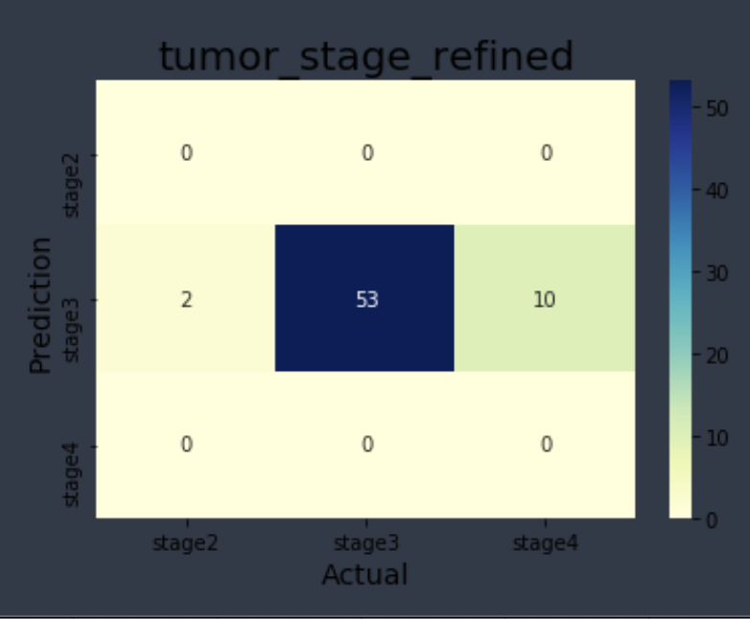
Ovary cancer Heat map(standard)
Total : 331 samples / Parameter : Train(0.7),Test(0.2),Validation(0.1/)Test Data : 65 samples

Slide 53
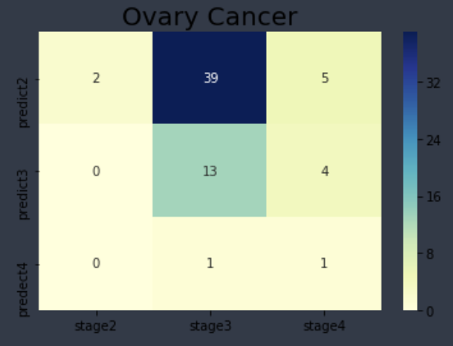
Ovary cancer Heat map(give weight)
Total : 331 samples / Parameter : Train(0.7),Test(0.2),Validation(0.1/)Test Data : 65 samples
stage2 weight ==(33/2)
stage3 weight == (33/53)
stage4 weight == (33/10)

Slide 54
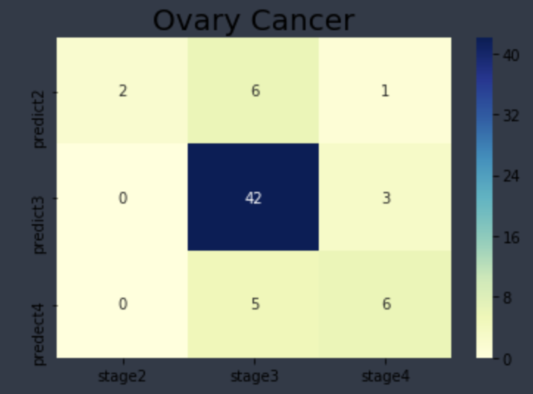
Specific stage classification & fixed DNN model (07/30)
feature_gene_selection |  | 22205 → 14812
input_dim |  | 331
train:test:validation |  | 7:2:1
Autoencoder | test.loss | 0.064
 | train.loss | 0.061
DNN | test.acc | 0.77
 | train.acc | 0.75

Slide 55
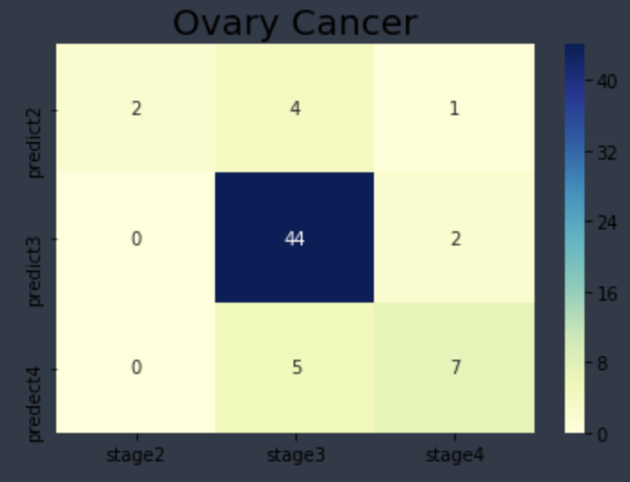
Specific stage classification & fixed DNN model (08/13)
feature_gene_selection |  | 14812
input_dim |  | 331
train:test:validation |  | 7:2:1
DNN | test.acc | 0.81
 | train.acc | 0.80

Slide 56
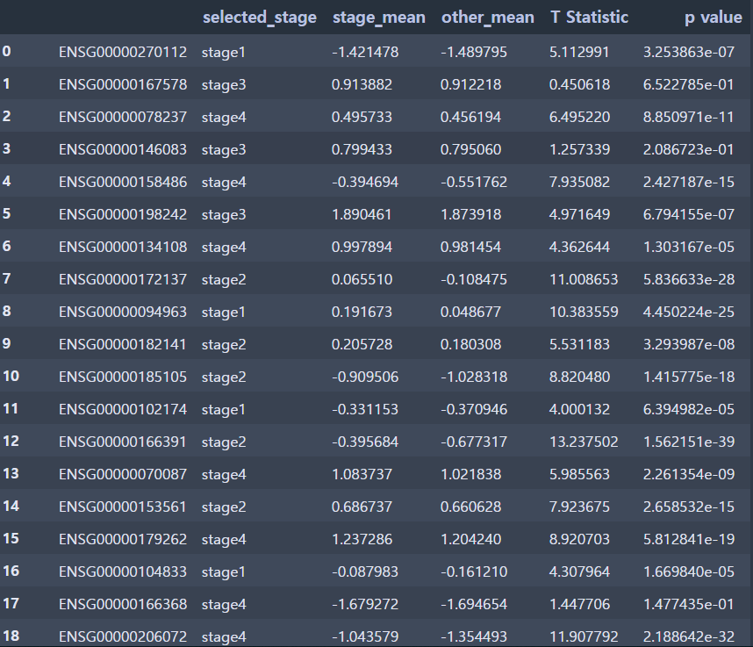
feature selection
각 TCGA에 따른 유전자를 stage1,2,3,4별로 서로 비교하였을 때 가장 높은 점수를 획득한 stage를 나타낸 유전자를 표시한 것으로 ovary cancer model에 사용된 것은 stage1을 제외한 stage2,3,4,의 유전자로만 사용하였다.(ovary cancer에는 stage1가 명시되어 있는 data가 존재하지 않음)
총 22205개의 유전자 중 stage1을 제외한 나머지의 유전자를 선별했을 때 14812개의 유전자를 얻을 수 있었다.

Slide 57
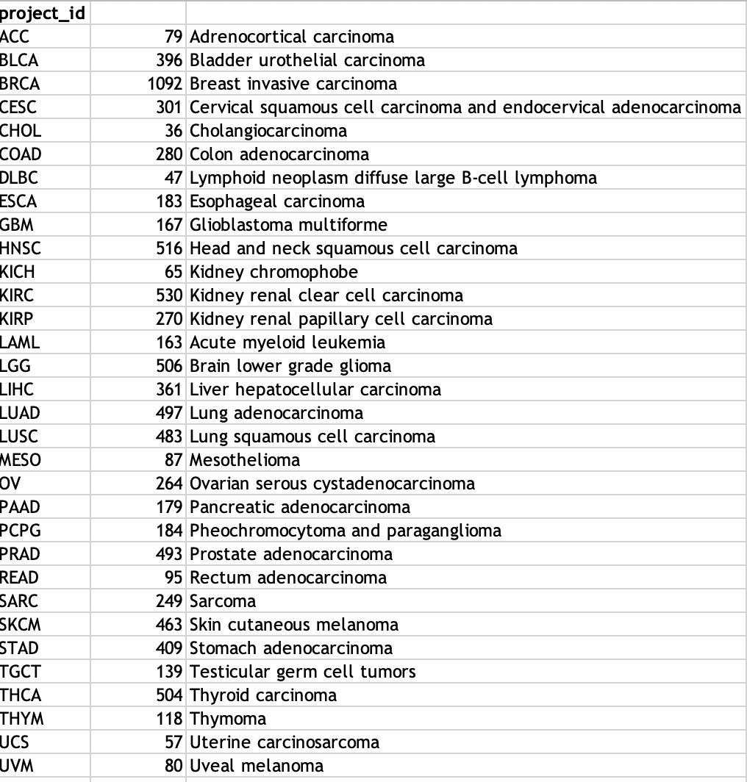
pancancer Human IO 360(total)
Level 3 RSEM-normalized RNASeqV2 data & level 3 mutation
feature_gene_selection |  | 22205
input_dim |  | 9293
train:test:validation |  | 7:2:1
Autoencoder | test.loss | 0.345
 | train.loss | 0.361
 | layer | 4
 | node_proportion | 0.6 .0.8 0.6.0.8
 | optimizer,loss | adadelta, MSE

